Slide 1
Artificial Intelligence CSC 361
Tutorial#7

Slide 2
Q1
Consider a world composed of three objects A, B and C. The rules of this world are the following:
1. If A is on the right of B, then B is on the left of A 2. If C is on the top of B which is on the left of A, then it is not on the top of A.
Translate these rules into propositional logic.
If you know that in such world, A is on the right of B and C on the top of B, Can you deduce from the previous facts that C is not on the top of A.

Slide 3
Answer
Rules
R1: Right_{AB} ⇒ Left_{BA}
R2: Top_{CB} ∧ Lleft_{BA} ⇒ ¬Top_{CA}
The facts are:
– F1: Right_{AB}
– F2: Top_{CB}.
• Prove ¬Top_{CA}:
– F3: Left_{BA}, F1 & R1 Modus Ponens – F4: Top_{CB} ∧ Left_{BA} , F2 & F3 And-introduction
– F5: ¬Top_{CA} R2 & F4 Modus Ponens

Slide 4
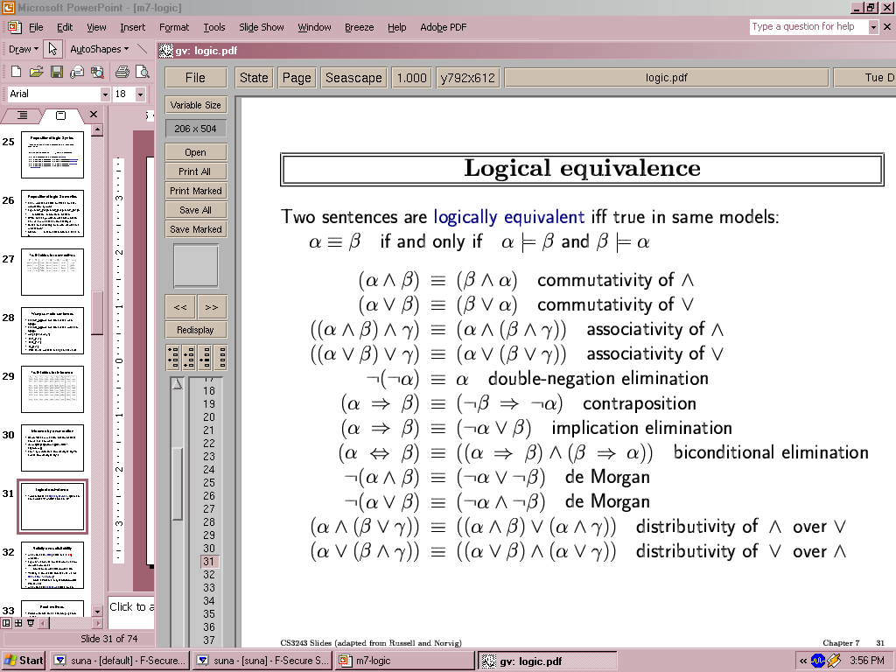
Use propositional logic inference rule to show that
An inference rule: Modus Ponens
α ⇒ β, α Premise
___________
β Conclusion
An inference rule: AND elimination
α1∧ α2∧ … αn Premise
_______________
αi Conclusion
An inference rule: Resolution
l1 V l2, ¬l2 V l3
l1 V l3

Slide 5
Use propositional logic inference rule to show that
1
KB: •A1:(R ⇒ ¬S)∧(T ⇒ ¬U) •A2:(V ⇒ ¬W)∧(X ⇒ ¬Y) •A3:(T ⇒ W)∧(U ⇒ ¬Y) •A4:(V ∨R)
entails (¬T ∨ ¬U ).
A5: T ⇒ ¬U, A1, And elimination
A6: ¬T ∨ ¬U , A5, implication elimination

Slide 6
Use propositional logic inference rule to show that
2
KB: • A1: R∨T • A2: Q∧U • A3: (S∨T) ⇒ (Q ⇒ P) • A4: ¬R∨S
entails P.
A5:S ∨T A1,A4, Resolution
A6: (Q ⇒ P) A3,A5, Modus Ponens
A7: Q, A2, and elimination
A8: P, A7 & A6, Modus Ponens

Slide 7
Use propositional logic inference rule to show that
3
KB: • A1: S_{1,1} ⇔ W_{1,2} ∨ W_{2,1} • A2: ¬S_{1,2} • A3: S_{1,1} • A4: ¬W_{2,2} • A5: ¬W_{1,2}
entails W_{2,1}.
A6: (S_{1,1} ⇒ W_{1,2} ∨ W_{2,1}) ∧ (W_{1,2} ∨ W_{2,1} ⇒ S_{1,1}), Biconditional elimination
A7: S_{1,1} ⇒ W_{1,2} ∨ W_{2,1}, A6, And elimination
A8: W_{1,2} ∨ W_{2,1}, A7 & A3, Modus Ponens
A9: W2,1, A8 & A5, Resolution

Slide 8
Q3. Use the resolution rule to show that KB |= α, KB :
To prove KB |= α, we need to show that KB ∧ ¬α is not satisfiable.
First we convert KB ∧ ¬α to CNF (conjunctive normal form).
Very important: When you convert to CNF, use only logical equivalences. Do not use and elimination, Modus Ponens or resolution, because the new sentence will not be equivalent to the original (you loose information).
KB: • A1: S_{1,1} ⇔ W_{1,2} ∨ W_{2,1} • A2: ¬S_{1,2} • A3: S_{1,1} • A4: ¬W_{2,2} • A5: ¬W_{1,2}
α= W_{2,1}.

Slide 9
A6: (S_{1,1} ⇒ W_{1,2} ∨ W_{2,1}) ∧ (W_{1,2} ∨ W_{2,1} ⇒ S_{1,1}), A1, Biconditional elimination
A7:(¬S_{1,1} ∨ W_{1,2} ∨ W_{2,1}) ∧ (¬ (W_{1,2} ∨ W_{2,1}) ∨ S_{1,1}), A6, Implication elimination
A8: (¬S_{1,1} ∨ W_{1,2} ∨ W_{2,1}) ∧ ((¬W1,2 ∧ ¬W2,1) ∨ S1,1), A7, De Morgan
A9: (¬S1,1 ∨ W1,2 ∨ W2,1) ∧ (¬W1,2 ∨ S1,1) ∧ (¬W2,1 ∨ S1,1) A8, Distribuitivity of ∨ over ∧.

Slide 10
Now KB ∧ ¬α looks like:
• B1: ¬S_{1,1} ∨ W_{1,2} ∨ W_{2,1}
• B2: ¬W_{1,2} ∨ S_{1,1} • B3: ¬W_{2,1} ∨ S_{1,1} • B4: ¬S_{1,2} • B5: S_{1,1} • B6: ¬W_{2,2} • B7: ¬W_{1,2} • B8: ¬W_{2,1} (this is ¬α)
Now, we can apply resolution: • B9: W_{1,2} ∨ W_{2,1}, B1 & B5 • B10: W_{2,1}, B9 & B7 • B11: Empty clause, B10 & B8
Since we derived the empty clause (which means a contradiction),
we deduce that KB |= α.
W_{2,1}

Slide 11
Q4: Consider the following KB:
• A ∧ B ⇒ E
• A ∧ D ⇒ C
• E ⇒ F • B ∧ E ⇒ D
• C ⇒ F
• D ∧ F ⇒ G
•A •B

Slide 12
1. What is the standard form in which the KB is written?
The KB is in Horn form.

Slide 13
2. Draw the And-Or graph that represents the KB.
G
• A ∧ B ⇒ E
• A ∧ D ⇒ C
• E ⇒ F • B ∧ E ⇒ D
• C ⇒ F
• D ∧ F ⇒ G
F
C
D
E
B
A

Slide 14
3. Use forward and backward chaining to show that KB |= G.
G
F
Facts | Clauses
A, B A, B , E A, B, E, F A, B, E, F, D A, B, E, F, D, C A, B, E, F, D, C, G | A ∧ B ⇒ E E ⇒ F B ∧ E ⇒ D A ∧ D ⇒ C D ∧ F ⇒ G
C
D
E
B
A

Slide 15
G
Facts | Goals | Clauses
A, B A, B A, B A, B, E A, B, E, D A, B, E, D, F A, B, E, D, F, G | G G, F, D G, F, D, E G, F, D G, F G | D ∧ F ⇒ G B ∧ E ⇒ D A ∧ B ⇒ E B ∧ E ⇒ D E ⇒ F D ∧ F ⇒ G
F
C
D
E
B
A

